Slide 1

ADWAIT TORO
FOUNDATIONS OF BUSINESS ANALYTICS

Slide 2
GOAL DEFINITION
To identify the relationship between different parameters so as to understand what exactly are the factors that decide the fate of a student of acceptance chances for certain universities.

Slide 3
VARIABLES
Dependent Variable –
ChanceOfAdmit
Independent Variables –
GREScore
TOEFLScore
SOP
LOR
CGPA
UniversityRating
Research

Slide 4
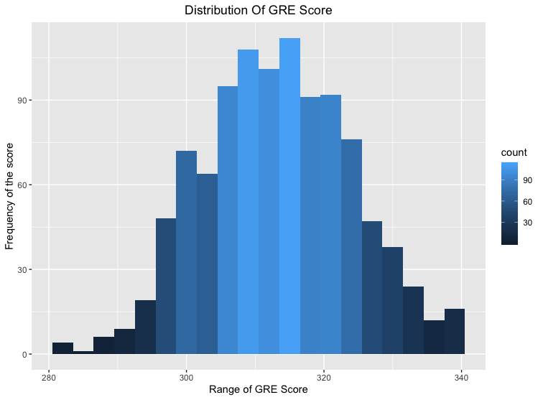

Slide 5
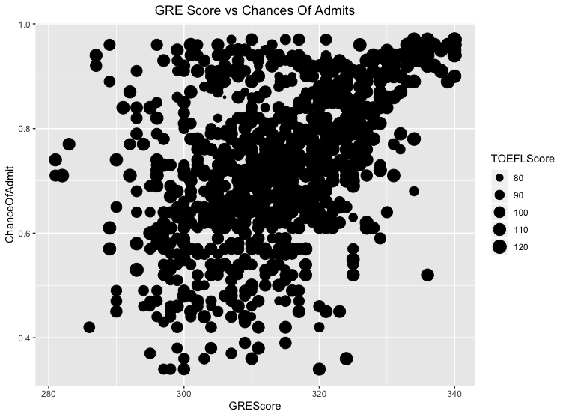

Slide 6
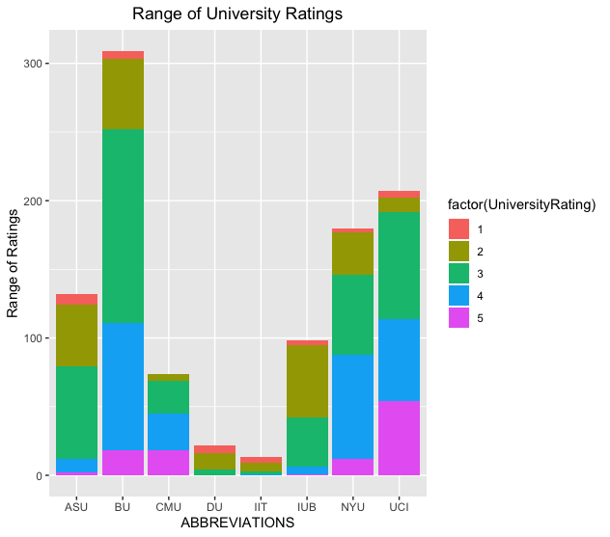

Slide 7
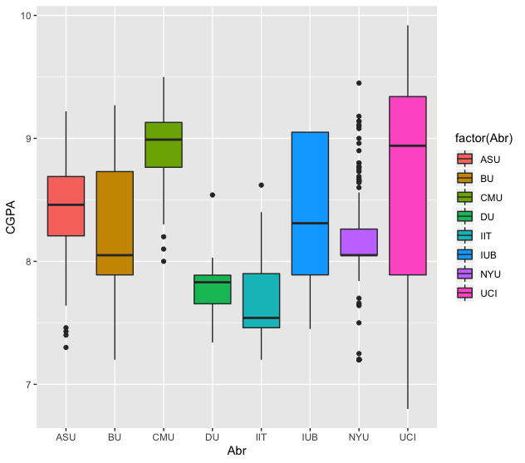

Slide 8
1) data: ChanceOfAdmit and SOP
t = 10.12, df = 1033, p-value < 2.2e-16
alternative hypothesis: true correlation is not equal to 0
95 percent confidence interval:
0.2438615 0.3547767
sample estimates:
cor
0.300334
Thus, having a good SOP influences the chances of getting an admit by 30%.
3) data: ChanceOfAdmit and TOEFLScore
t = 9.3155, df = 1033, p-value < 2.2e-16
alternative hypothesis: true correlation is not equal to 0
95 percent confidence interval:
0.2211994 0.3336580
sample estimates:
cor
0.2783826
Thus, having a good TOEFL score influences the chances of getting an admit by 27.8%.
2) data: ChanceOfAdmit and GREScore
t = 15.179, df = 1033, p-value < 2.2e-16
alternative hypothesis: true correlation is not equal to 0
95 percent confidence interval:
0.3758839 0.4755977
sample estimates:
cor
0.4270381
Thus, having a good GRE score influences the chances of getting an admit by 42.7%
4) data: ChanceOfAdmit and LOR
t = 9.4865, df = 1033, p-value < 2.2e-16
alternative hypothesis: true correlation is not equal to 0
95 percent confidence interval:
0.2260484 0.3381863
sample estimates:
cor
0.2830845
Thus, having a good LOR influences the chances of getting an admit by 28.3%.

Slide 9
5) data: ChanceOfAdmit and CGPA
t = 12.182, df = 1033, p-value < 2.2e-16
alternative hypothesis: true correlation is not equal to 0
95 percent confidence interval:
0.2999639 0.4065758
sample estimates:
cor
0.3544211
Thus, having a good CGPA score influences the chances of getting an admit by 35.4%
6) data: ChanceOfAdmit and Research
t = 9.3662, df = 1033, p-value < 2.2e-16
alternative hypothesis: true correlation is not equal to 0
95 percent confidence interval:
0.2226371 0.3350012
sample estimates:
cor
0.2797769
Thus, having a good Research score influences the chances of getting an admit by 27.9%

Slide 10
REGRESSION
Coefficients:
Estimate Std. Error t value Pr(>|t|)
(Intercept) -1.1548541 0.1087451 -10.620 < 2e-16 ***
GREScore 0.0040400 0.0003942 10.248 < 2e-16 ***
TOEFLScore 0.0022922 0.0005265 4.353 1.47e-05 ***
SOP 0.0165485 0.0068441 2.418 0.01578 *
LOR 0.0188096 0.0072628 2.590 0.00974 **
CGPA 0.0263738 0.0070421 3.745 0.00019 ***
---
Signif. codes: 0 ‘***’ 0.001 ‘**’ 0.01 ‘*’ 0.05 ‘.’ 0.1 ‘ ’ 1
Residual standard error: 0.1195 on 1029 degrees of freedom
Multiple R-squared: 0.2908, Adjusted R-squared: 0.2873
F-statistic: 84.38 on 5 and 1029 DF, p-value: < 2.2e-16

Slide 11
The Regression Equation is given as : -
ChanceOfAdmit = -1.154 + 0.004GREScore + 0.002TOEFLScore + 0.016SOP + 0.018LOR + 0.026CGPA
Interpretation: -
The Chances of getting an admit increase by 0.004 with a unit increase in GREScore, keeping all other parameters constant.
The Chances of getting an admit increase by 0.002 with a unit increase in TOEFLScore, keeping all other parameters constant.
The Chances of getting an admit increase by 0.016 with a unit increase in SOP score, keeping all other parameters constant.
The Chances of getting an admit increase by 0.018 with a unit increase in LOR score, keeping all other parameters constant.
The Chances of getting an admit increase by 0.026 with a unit increase in CGPA, keeping all other parameters constant.

Slide 12
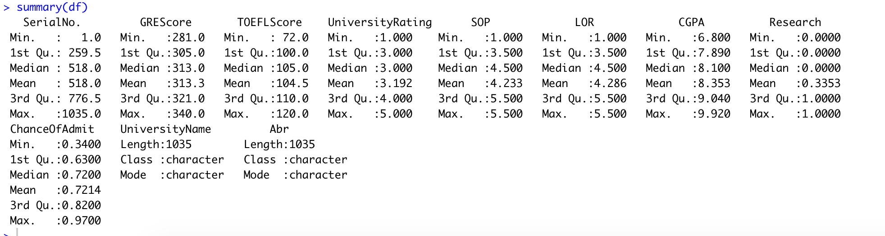
FINDINGS: -
The Box-plot for CGPA show that there are many outliers which influence the entire data set.
Descriptive statistics for each column: -
After observing the scatter plot, it can be concluded that the TOEFL and GRE scores together show a positive correlation to Chances of Getting an admit. More the value of GRE and TOEFL scores, higher are the chances of getting an admit.

